Slide 1

Vel Tech Rangarajan Dr. Sagunthala R&D Institute of Science and Technology
School of Computing
Department of Computer Science and Engineering
10211CS224 / FULL STACK APPLICATION DEVELOPMENT (JAVA)
END SEMESTER PROJECT REVIEW
Date:06-05-2026
EVENT TICKET BOOKING SYSTEM
SDG: SDG 4 – Quality Education
Presented By:
G.Varun – VTU26421 – 23UECS1073
Courses Handling Faculty:
Dr.M.SUMITHRA –ASSISTANT PROFESSOR(SG)

Slide 2
INTRODUCTION
1
The Technical Fest Ticket Booking Platform is a comprehensive web-based application designed to offer a seamless and efficient way for users to book tickets for various college fest events, workshops, and competitions. This system replaces manual ticketing processes, enabling users to seamlessly browse upcoming events, view detailed descriptions, and reserve tickets in real-time. The frontend is built with React using Visual Studio Code, delivering a highly interactive and responsive user experience. The backend is powered by Spring Boot and developed in Eclipse, leveraging a robust microservices architecture (including an API Gateway and Eureka Service Registry) to ensure high scalability, flexibility, and maintainability. Data management is handled securely by a MySQL database, which stores user profiles, event information, and booking histories. Ultimately, this platform streamlines the ticketing experience for attendees while empowering fest organizers with an efficient tool to manage event registrations.
2
3
4
5
6
7
8
9

Slide 3
PROBLEM STATEMENT
1
The current technical fest ticket booking process often relies on manual methods or monolithic, inefficient systems. This leads to issues such as long registration queues, delayed booking confirmations, lack of real-time availability updates, and increased chances of human error. Students and attendees find it difficult to get accurate, up-to-date information about fest events, seat availability, and their booking status. Simultaneously, event organizers struggle to manually manage registrations, track bookings, and handle large volumes of participant data efficiently. Furthermore, traditional systems often lack the scalability and flexibility required to handle the high traffic of multiple concurrent fest events. Therefore, there is a critical need for a reliable, secure, and automated ticket booking platform that provides real-time updates, simplifies the user experience, and ensures efficient data management leveraging modern, scalable technologies like a microservices architecture.
2
3
4
5
6
7
8
9

Slide 4
OBJECTIVE(S)
1
To develop a highly interactive, user-friendly frontend platform (using React) that allows students and attendees to easily browse technical fest events, check real-time seat availability, and instantly book tickets without any manual intervention.
To provide event organizers with an automated system to effortlessly track event registrations, manage ticket capacities, and monitor overall fest engagement in real-time.
To design and implement a highly scalable and efficient backend system utilizing a Spring Boot microservices architecture (including an API Gateway and Service Registry) to ensure fault tolerance and seamless communication between services.
2
3
4
5
6
7
8
9

Slide 5
PROPOSED SYSTEM
1
24/7 Accessibility: Provides an online, automated platform for students and users to easily browse and book tickets for various technical fest events anytime and anywhere.
Real-Time Data: Displays real-time information, including detailed event descriptions, dynamic seat availability, and instant booking status confirmations.
Modern Frontend: Features a highly responsive and interactive frontend (developed using React in VS Code) to ensure a smooth, dynamic, and cross-platform user experience.
Robust Backend Architecture: Implements a powerful Spring Boot microservices-based backend (developed in Eclipse), utilizing an API Gateway to ensure maximum scalability, flexibility, and fault tolerance.
Modular Design: Employs isolated, dedicated microservices specifically for User Management, Event Cataloging, and Booking Operations to ensure the system remains highly maintainable.
Process Automation: Completely automates the ticketing lifecycle, significantly reducing manual errors, eliminating the need for physical tickets, and automatically preventing event overbooking.
2
3
4
5
6
7
8
9

Slide 6
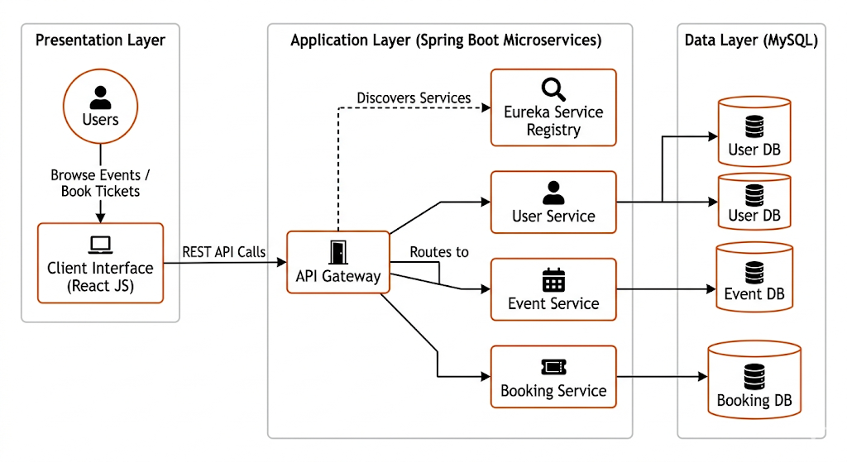
PROPOSED SYSTEM ARCHITECTURE
1
2
3
4
5
6
7
8
9

Slide 7
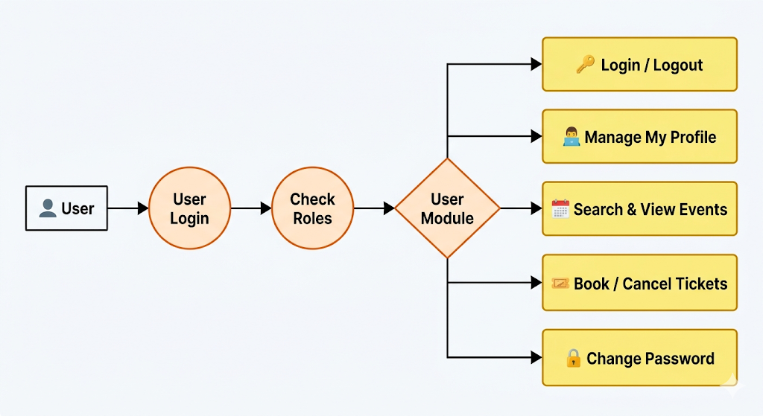
WORKFLOW
1
2
3
4
5
6
7
8
9

Slide 8
TECHNOLOGIES USED
1
2
Frontend: HTML5, CSS3, ReactJS (VS Code)
Backend: Java, Spring Boot Microservices with Spring Data JPA/ORM (Eclipse)
API Communication: RESTful APIs (Routed via Spring Cloud API Gateway)
Database: MySQL
3
4
5
6
7
8
9

Slide 9
MODULE DESCRIPTION
1
MODULE DESCRIPTION
Module 1: User Management Service
Handles secure user registration, login, and profile management for both attendees and event organizers.
Provides authentication and authorization to ensure users only access their own data.
Module 2: Event Management Service
Allows administrators and organizers to seamlessly create, update, and manage technical fest events.
Fetches and displays real-time event information to users, including schedules, descriptions, and total seat availability.
Module 3: Booking Management Service
Manages the entire ticket booking workflow, preventing overbooking through real-time seat allocation.
Generates booking confirmations, processes the transaction status, and securely updates the user's ticket history.
Module 4: API Gateway & Service Registry (Highlighting your Microservices!)
Acts as the central entry point, securely routing all frontend React requests to the correct backend microservice.
Utilizes the Eureka Naming Server for dynamic service discovery, ensuring the system remains fault-tolerant and scalable.
Module 5: Database Management (MySQL)
Securely stores isolated data for users, events, and bookings across dedicated database schemas.
Ensures high data integrity, efficient retrieval, and fast storage to handle high-traffic event registrations.
2
3
4
5
6
7
8
9

Slide 10
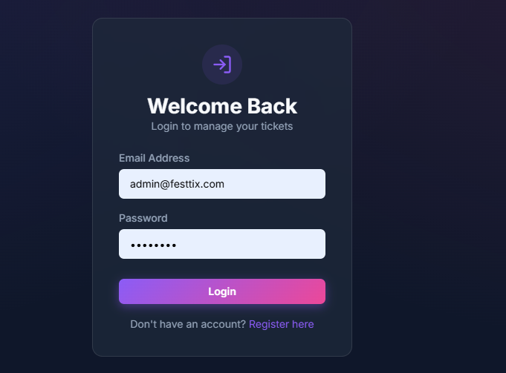
IMPLEMENTATION SCREENSHOTS
Home page
1
2
3
4
5
6
7
8
9

Slide 11
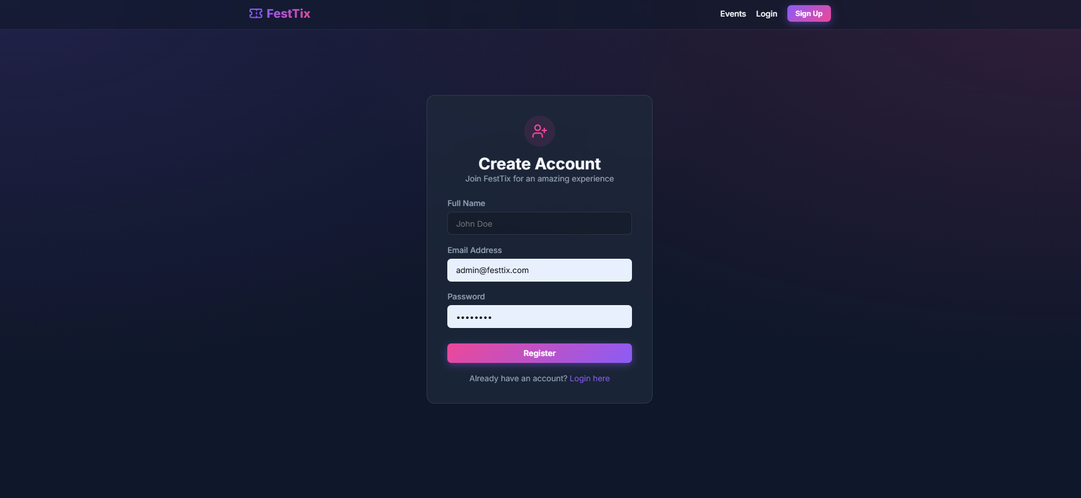
IMPLEMENTATION SCREENSHOTS
Sign Up page
1
2
3
4
5
6
7
8(A)
9

Slide 12
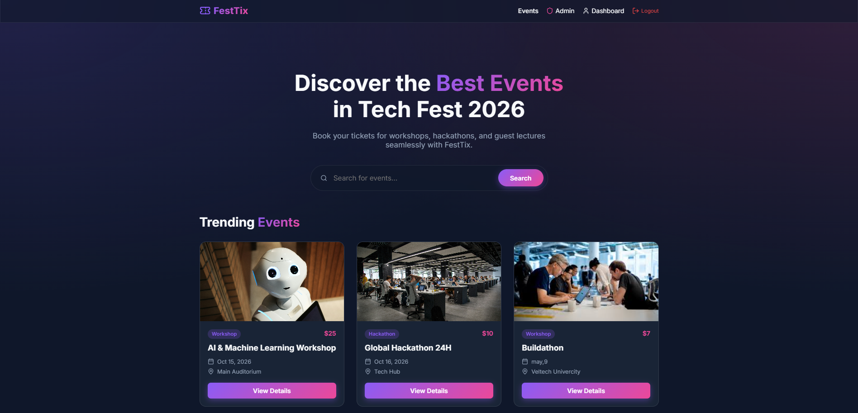
IMPLEMENTATION SCREENSHOTS
Main module
1
2
3
4
5
6
7
8(B)
9

Slide 13
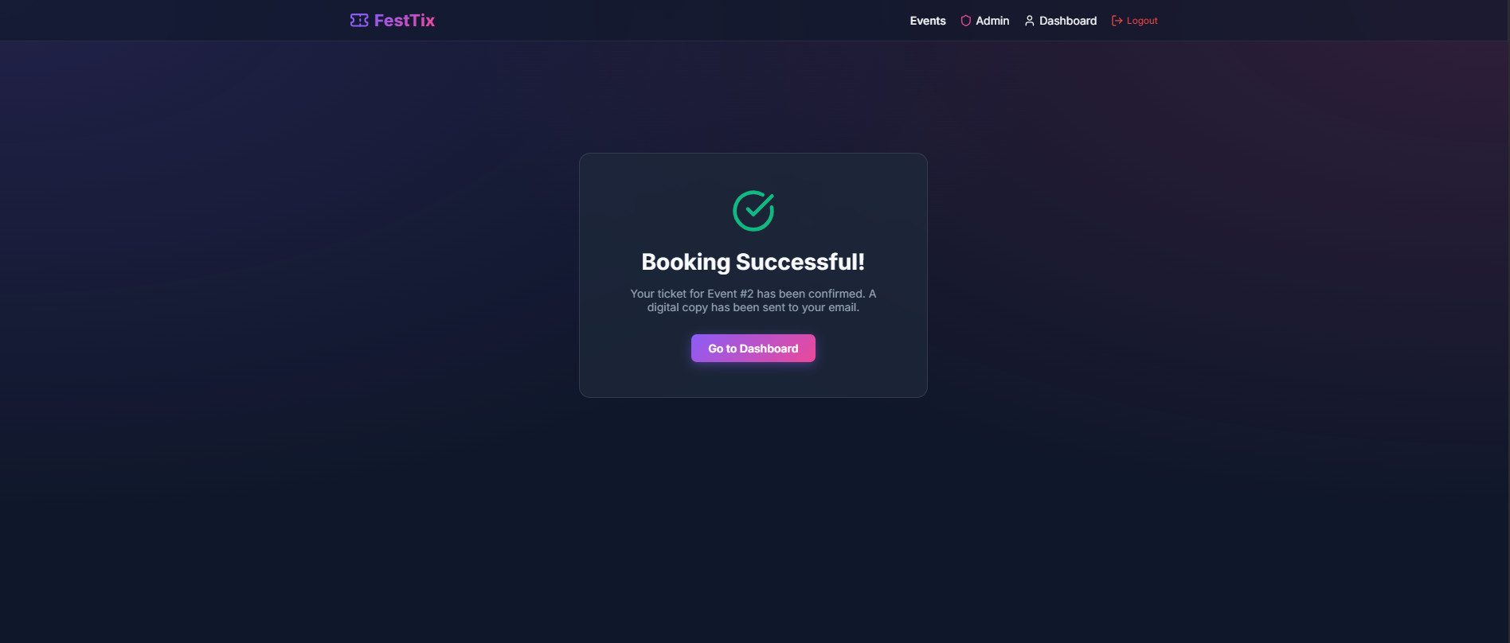
IMPLEMENTATION SCREENSHOTS
Output page
1
2
3
4
5
6
7
8(C)
9

Slide 14
ADVANTAGES & LIMITATIONS
ADVANTAGES & LIMITATIONS:
- ADVANTAGES:
24/7 Accessibility: Provides round-the-clock online ticket booking, completely eliminating the need for physical queues.
Real-Time Updates: Instantly displays live event details and dynamic seat availability.
High Accuracy: Automates the ticketing process to reduce manual errors and prevent overbooking.
Enhanced User Experience: Offers a fast, seamless, and convenient booking interface built with React.
- LIMITATIONS:
Internet Dependency: Requires a stable internet connection for users to browse events and book tickets.
Development Complexity: The initial setup and development of a full-stack microservices architecture can be complex and time-consuming.
Server Reliance: Dependency on server uptime; any backend downtime directly affects the users' ability to book tickets.
Security Vulnerabilities: Like all web applications, it faces potential cyber threats if security protocols are not rigorously maintained.
1
2
3
4
5
6
7
8
9

Slide 15
Thank you

